Slide 1
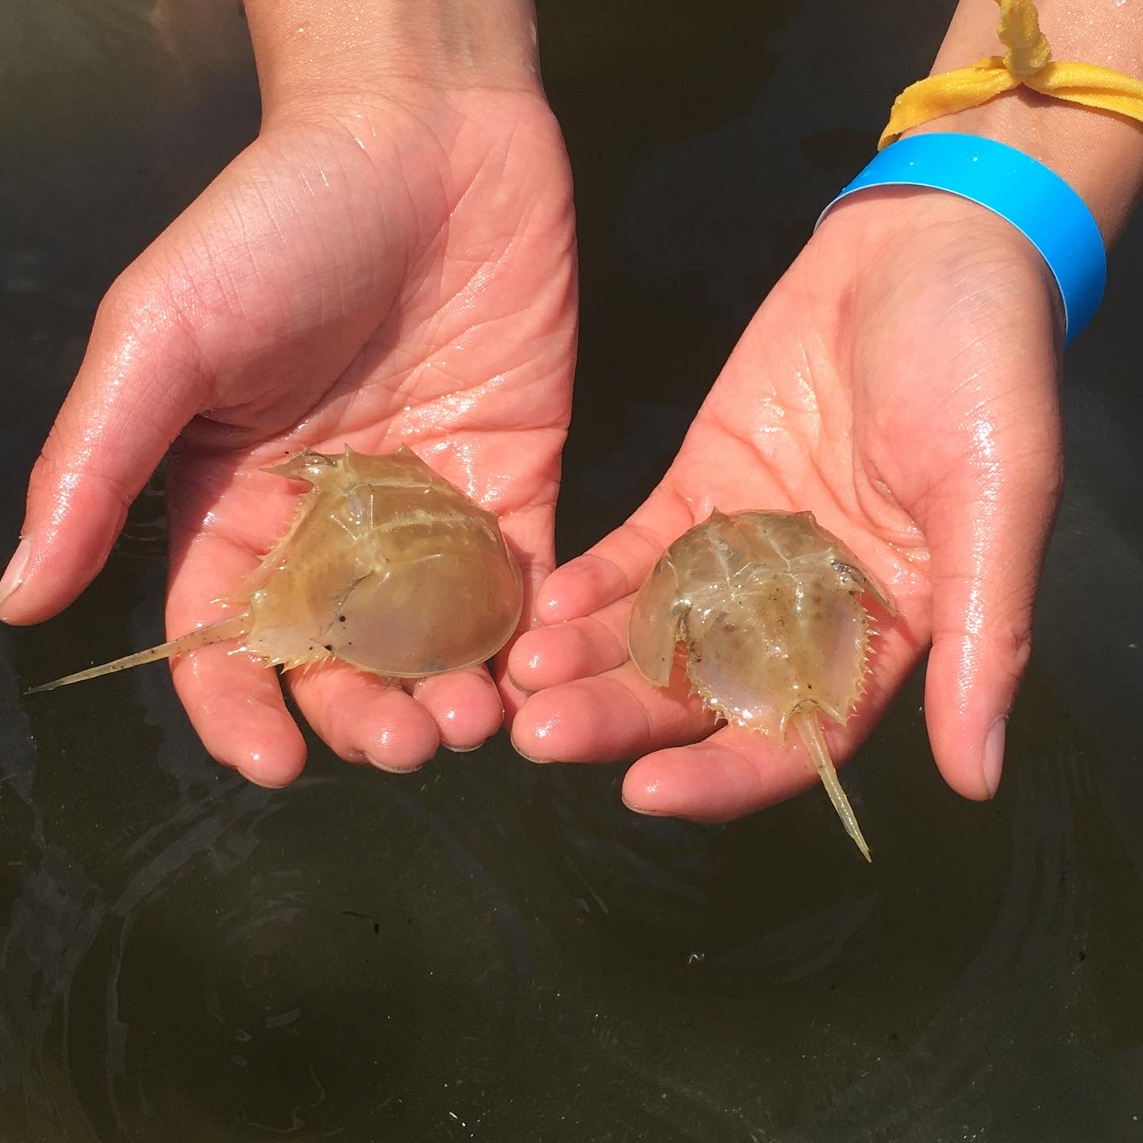
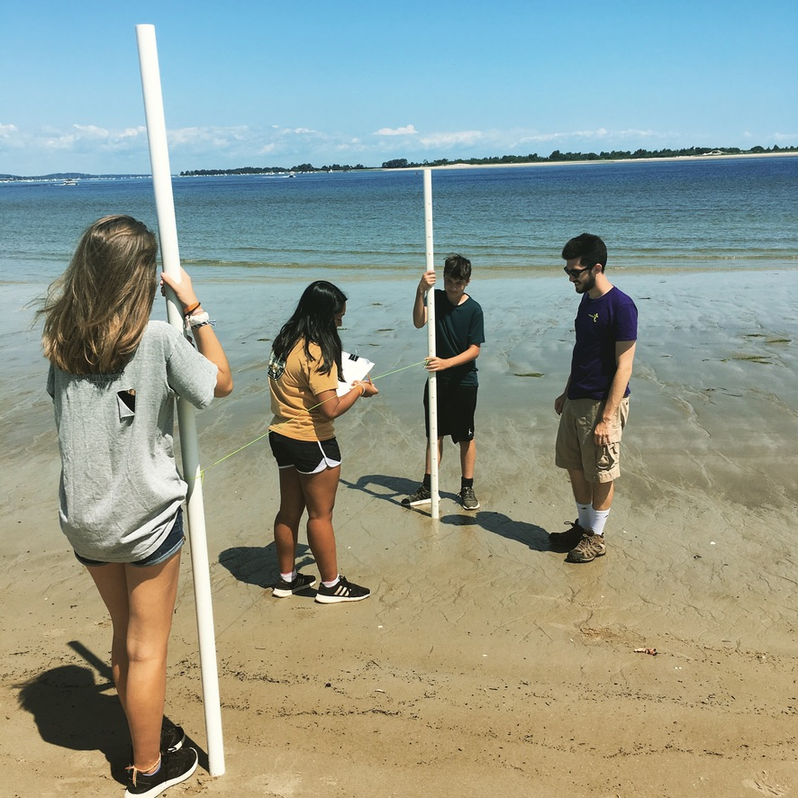
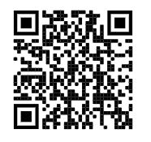
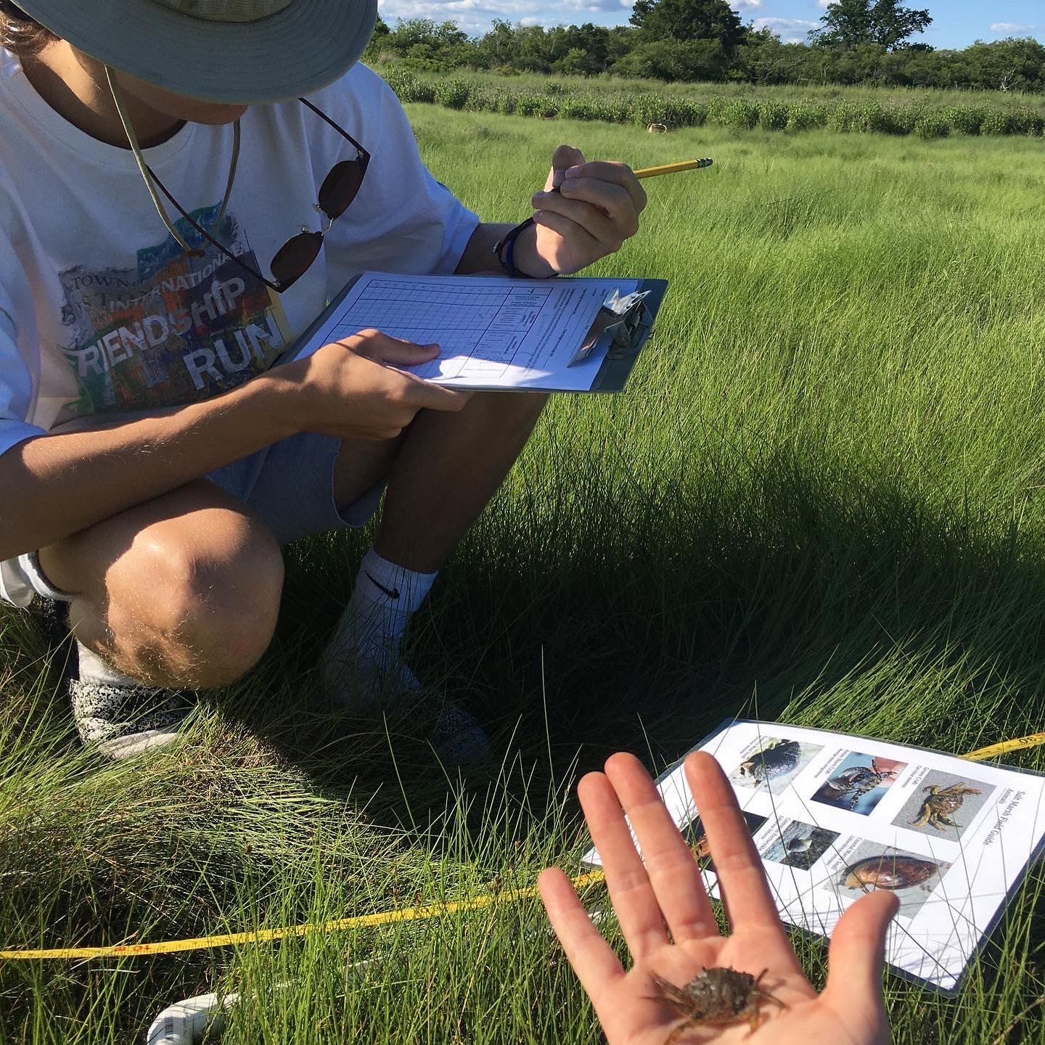
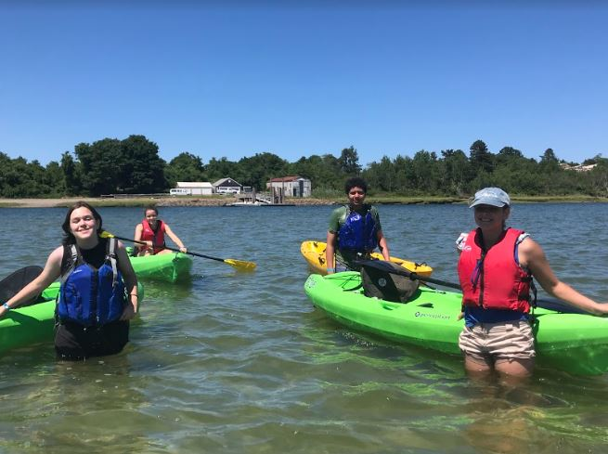
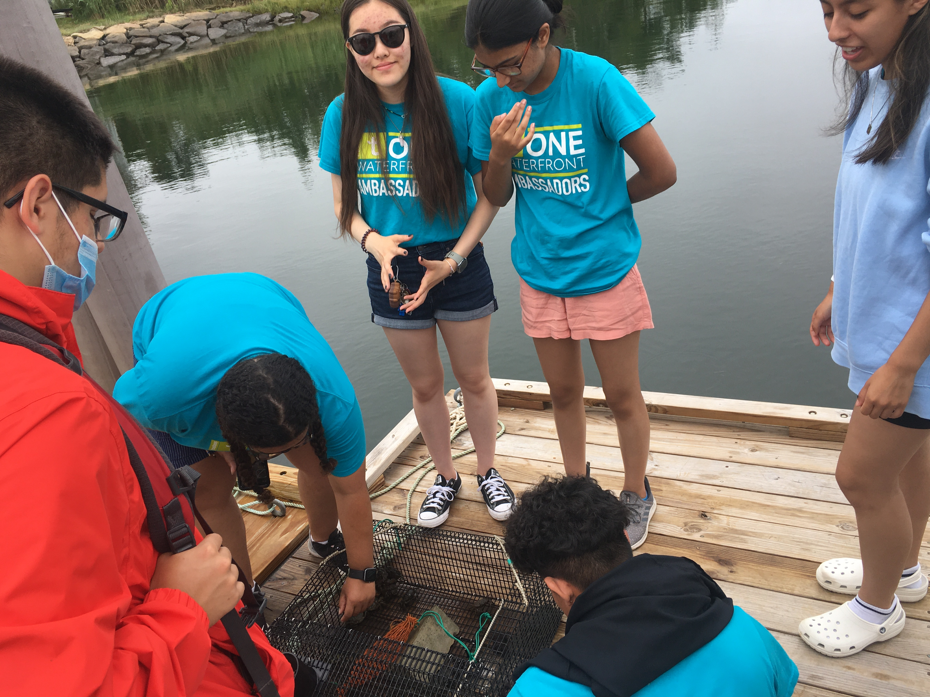
Teens 13-15
Join our Stewards Program!
Weeklong camp sessions
Summer fun
Build skills to care for YOUR coast
Learn about environmental careers
Make friends and meet mentors
thetrustees.org/program/summerquest-at-the-crane-estate-ipswich/
Scholarships
available!

