Slide 1
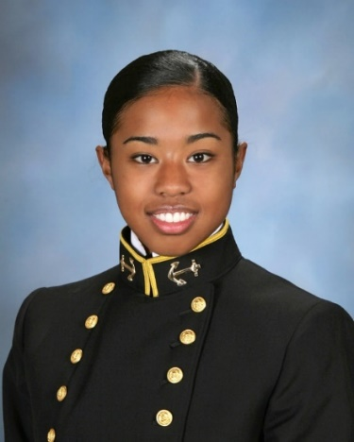
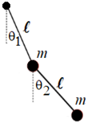
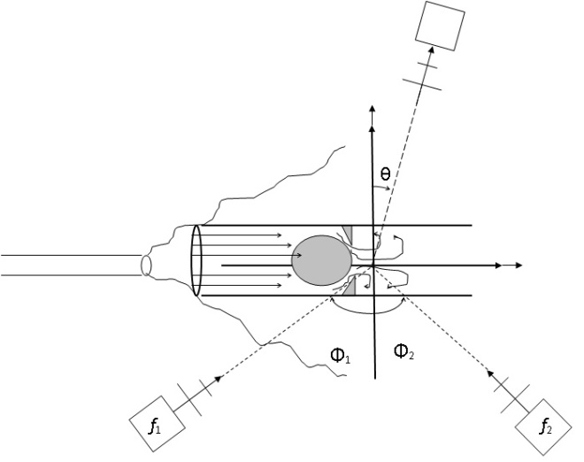
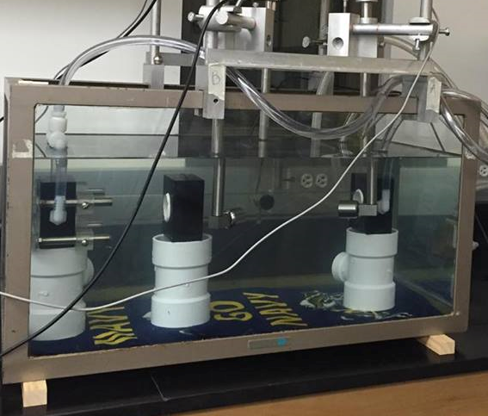
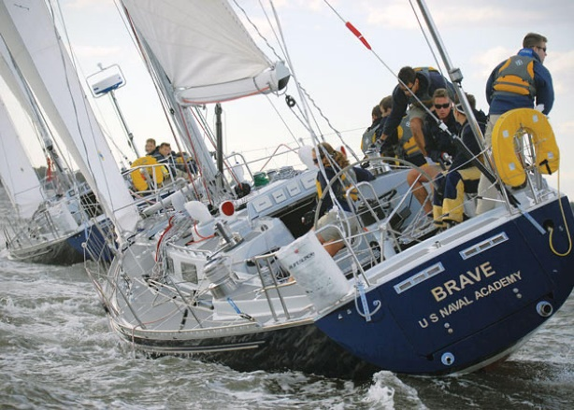
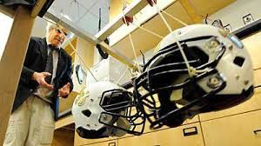
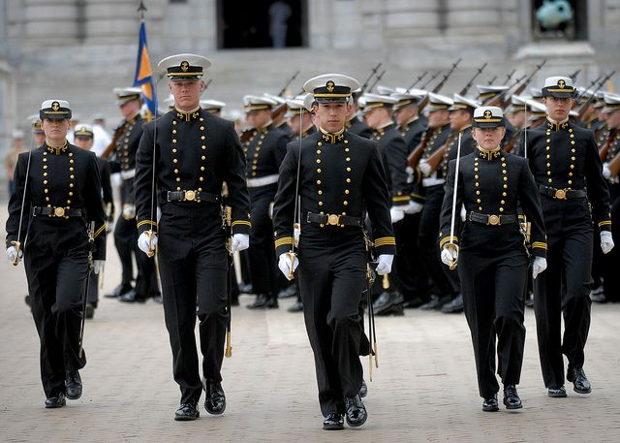
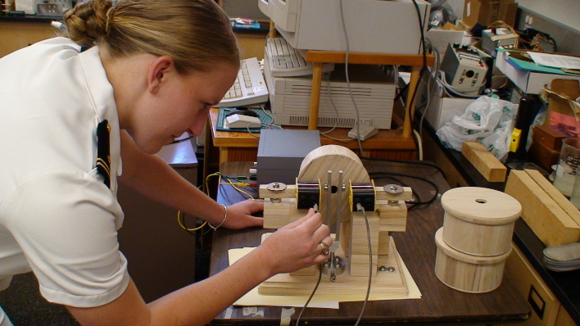
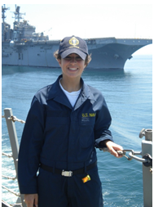
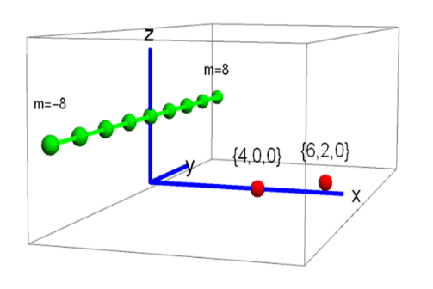
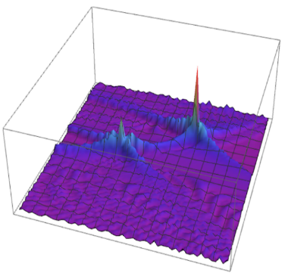
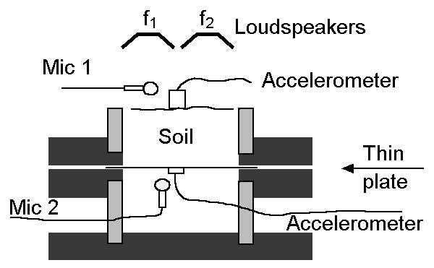
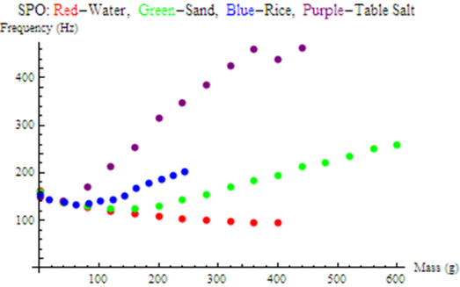
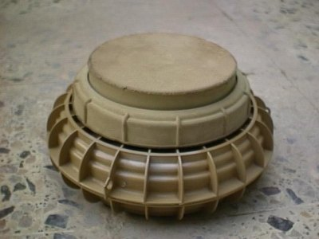
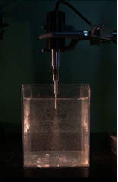
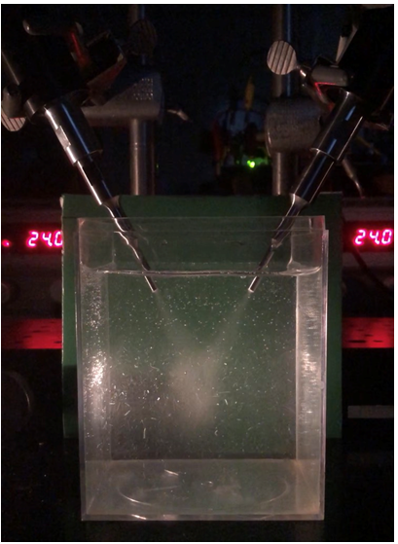
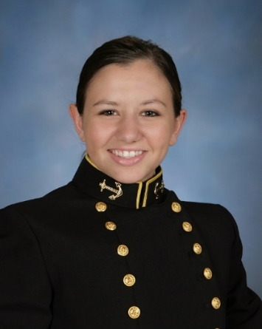
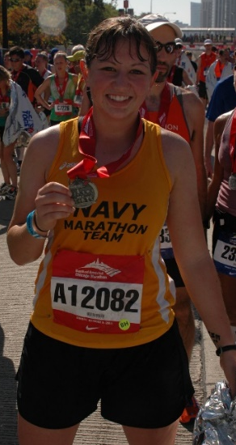
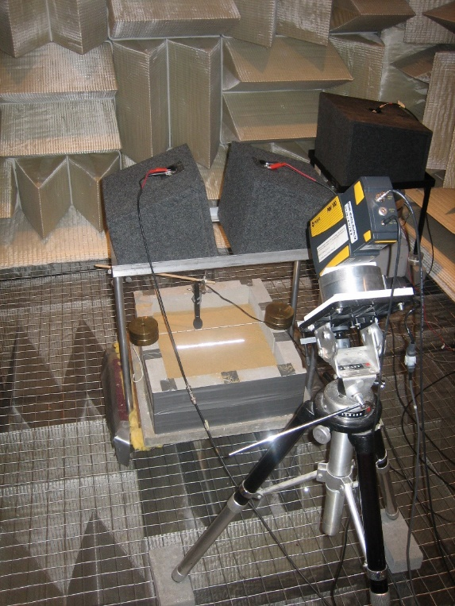
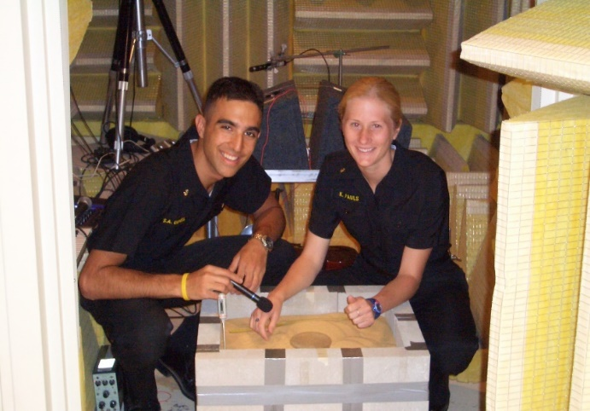
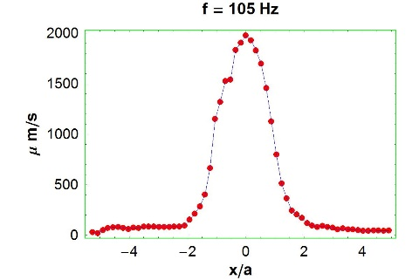
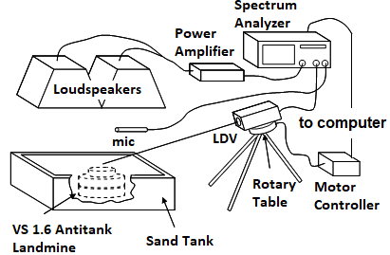
Midshipman 1/C: Acoustic Soc. Am. Meeting, Baltimore, MD ,“Hands-on outreach with GSA”; April 2010; Coupled Pendulums.
An obstruction to flow is added to the cylinder in order to simulate a blood clot or thrombosis, DVT.
Nonlinear Scattering of Sound by Sound
in the Presence of Turbulence
If you enjoy teaching, doing research with motivated and talented students, like small class sizes (24 maximum), and want your very own acoustics laboratory space; think you would like to mentor and advise future leaders, then maybe the U. S. Naval Academy is the place for you.
Announcement
Department of Physics
United States Naval Academy
Search for a Tenure TracK Assistant Professor Starting in August 2020
Hiring an Acoustician with a Desire
And Strong Potential to
Do Research IN Physical Acoustics
A Strong Commitment to Teaching is Required
Teaching Opportunities INCLUDE
Upper level courses for Majors
Acoustics
Underwater Acoustics and Sonar
Required Core courses For All Non-Majors
Calculus Based Physics:
Mechanics
(II) Electricity, Magnetism & Optics
Other courses For Physics Majors Include
Mathematical Methods in Physics
Mechanics I & II
HEAT LIGHT & SOUND
Formal Research Courses
For more Information Contact:
Physics Dept Chair: Professor DaryL Hartley
Tel: 410-293-6650
E-mail: hartley@usna.edu
Midshipmen underway in sailing exercises.
Concussion study: Helmet to helmet collisions.
Midshipmen drilling by Bancroft Hall for a parade.
Midshipman: Demonstrating Helmholtz Resonators.
SAR:
Geometry
Imaging:
Reflectance
Midshipman 1/C: Underwater Acoustics and
Sonar Studies. Currently in medical school.
Midn Research: Backprojection Strip-Mapped Synthetic Aperture Acoustic “Radar” SAR using two pt (red) targets. The green pts represent transmit/receiver positions.
VS 2.2 Anti-tank plastic landmine
The soil-plate-oscillator: circular clamped plate and soil column models acoustic landmine detection experiments. Mass loading vs. resonant frequency results.
VS 1.6 Inert Anti Tank Plastic Landmine:
Cross-section.
Nonlinear ultra-sonic turbulent streaming jet and
interaction of crossed turbulent streaming jets.
Student overcomes
injuries from 60 ft rock climbing fall …one year later…
Midshipman’s research:
Acoustic landmine detection.
Anechoic Chamber #1:
Midn 1/C Sean Genis: 2007 Rhodes Scholar (Oxford) and
Midn 1/C Kathleen Pauls 2007 (Naval Post Graduate School).
Anechoic Chamber #2: Airborne acoustic land- mine detection with remote LDV vibration sensor. Drum-like target is buried in the sand tank.
Airborne acoustic landmine detection experiment and sand surface vibration profile.

